Slide 1
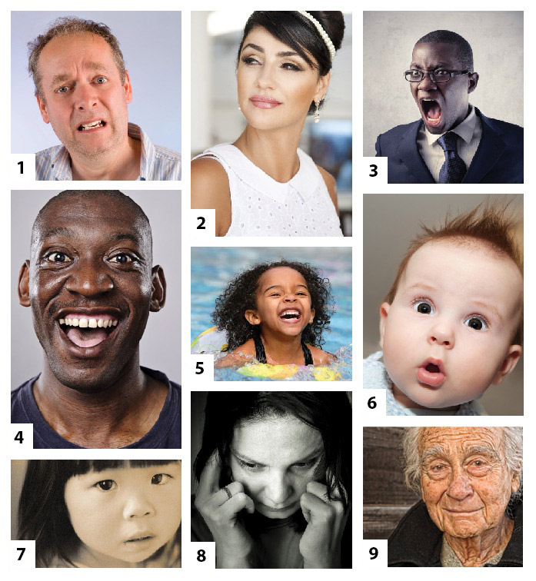
PR (A6) CO-324 -Sourabh 2K18/CO/355 -Vishruth Khare 2K18/CO/393 Under Guidance of: -Asst Prof Kavinder Singh
Emotion Recognition by
Analyzing Facial Expressions

Slide 2
An important aspect of human communication is the non-verbal interaction. It comprises mainly of facial expressions along with body language.
This paper encompasses various techniques for facial recognition to analyze key human emotions: happiness, sadness, anger, surprise, fear, disgust and neutral. Further we investigated them to predict the best model among them.
Introduction

Slide 3
Quite a lot of projects have previously been carried in this field. Nevertheless, none of these papers attempted to compare different existing models for the purpose of emotion recognition. Our aspiration will be to develop an Emotion Recognition System by analyzing various approaches along with the comparison to the other available systems.
Aspiration

Slide 4
Describe various all-inclusive facial expressions along with their features
Comparative study of popular techniques proposed earlier for Automatic Facial Emotion Recognition
Building different Models a training them
A comprehensive comparison of different models
Approach

Slide 5
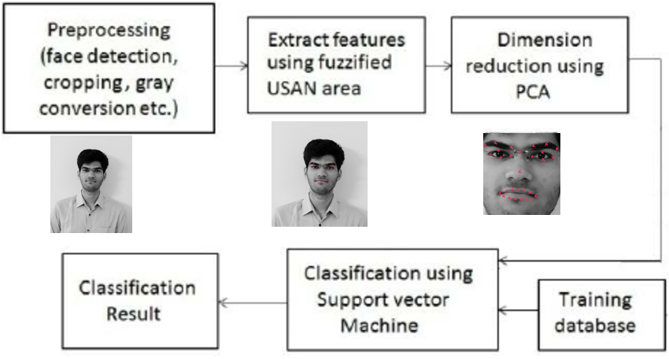
MACHINE LEARNING APPROACH
Using SV M
SVMs plot the training vectors in high-dimensional feature space, and label each vector with its class. A hyperplane is drawn between the training vectors that maximizes the distance between the different classes. The hyperplane is determined through a kernel function (radial basis, linear, polynomial or sigmoid), which is given as input to the classiﬁcation software.
Fuzzy Classifier
The algorithm is composed of three main stages: image processing stage and facial feature extraction stage, and emotion detection stage. In image processing stage, the face region and facial component is extracted by using fuzzy color ﬁlter, virtual face model, and histogram analysis method. The features for emotion detection are extracted from facial component in facial feature extraction stage.
We shall be using other ML models as well ( using the pipelining approach ) but the center of attraction is SVM model.

Slide 6
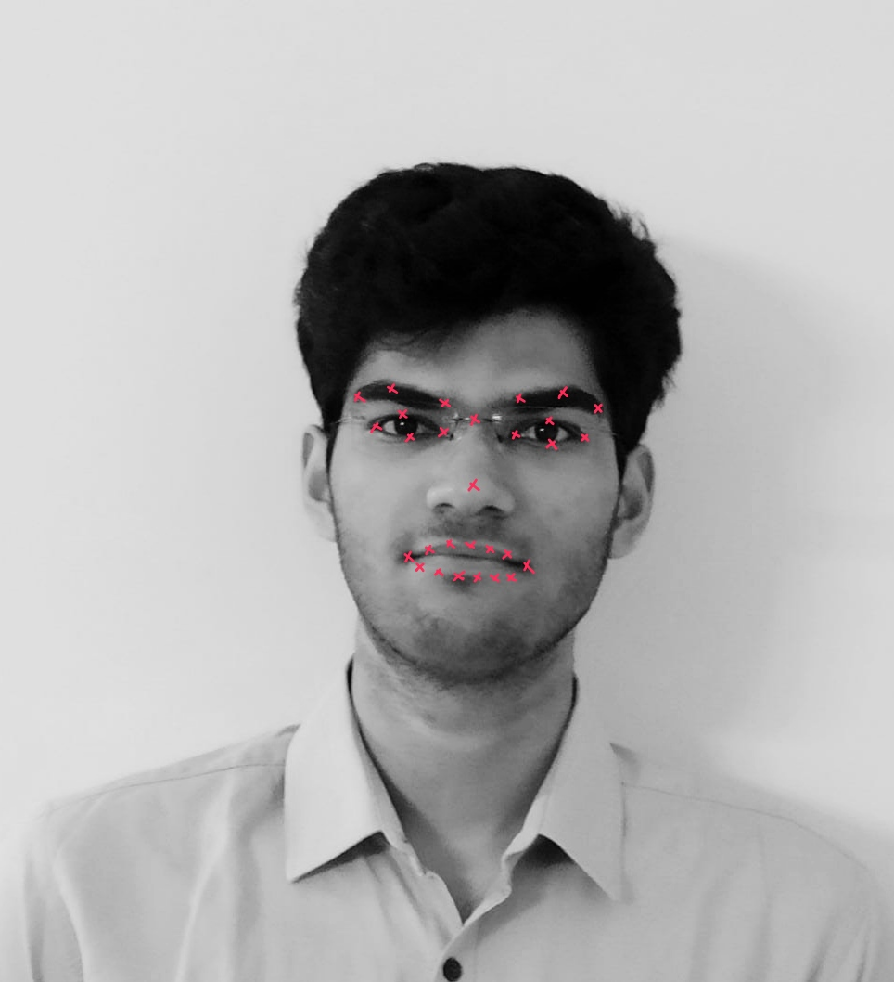
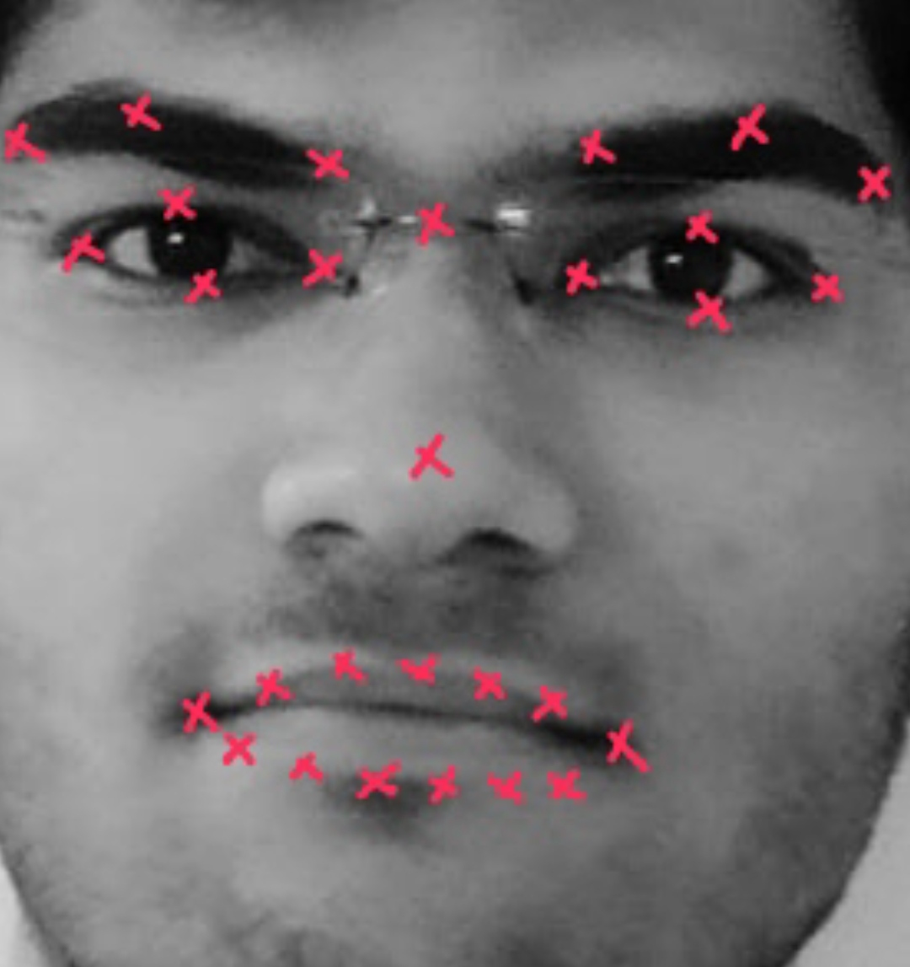

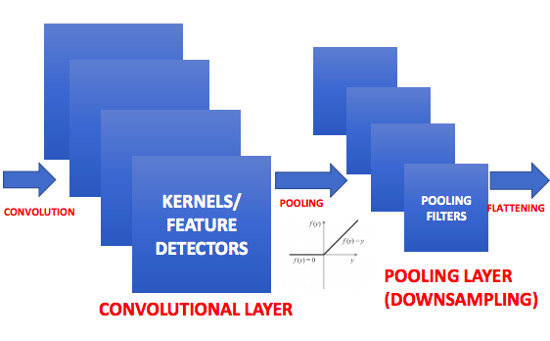
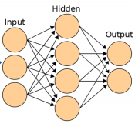
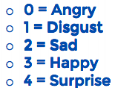
Deep Learning
Model Overview

Slide 7
CNN BASED ARCHITECTURE
Histogram of Oriented Gradients: A HOG relies on the property of objects within an image to possess the distribution of intensity gradients or edge directions. Gradients are calculated within an image per block. A block is considered as a pixel grid in which gradients are constituted from the magnitude and direction of change in the intensities of the pixel within the block.

Slide 8
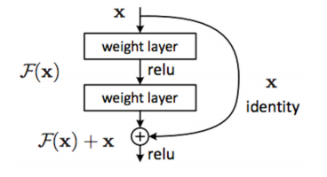
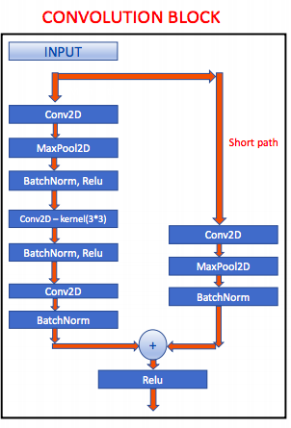
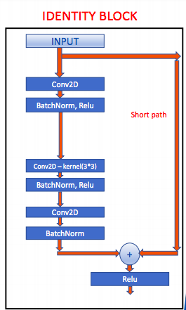
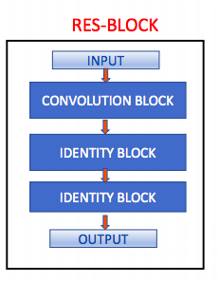
As CNNs grow deeper, vanishing gradient tend to occur which negatively impact network performance. Vanishing gradient problem occurs when the gradient is back -propagated to earlier layers which results in a very small gradient.
RES-NET BASED APPROACH
Residual Neural Network includes “skip connection” feature which enables training of many layers without vanishing gradient issues. Resnet works by adding “identity mappings” on top of CNN.

Slide 9

What’s next for us
We are following a pipeline based approach where the pre-processing phase remains same to all the
Models and with slight change in the type of input required by the Model, the accuracy can be evaluated.
Therefore our Monolith is prepared
Data Cleaning has been done with. Noises removed.
Pre-processing: The vital phase of our pipeline is the preparation of data into consumable format and that has also been done with..
Modeling : The models are almost ready and functional. With minor adjustments, we shall be also to feed in the data in the format we have extracted earlier.
Deployment and Analysis : Once the input array is in the relevant format, we shall immediately start ingesting the pre-processed dataset into the model and obtain the accuracy scores,Confussion Matrix, recoil score, f-score, etc.
Done Done in-process Queued

